Slide 1
PR bleeding and anticoagulants
Jo Stringer
Notes:
<number>

Slide 2
Why investigate
Anecdotal evidence
Novel anticoagulant use is increasing
More patients being admitted on NOACs
Possibly more severe bleeding
No method of monitoring use or reversing action
Notes:
<number>

Slide 3
Aims
Are more patients being admitted over time for PR bleeding while taking NOACs
Is this bleeding more severe
Longer stay
Lower haemoglobin
Notes:
<number>

Slide 4
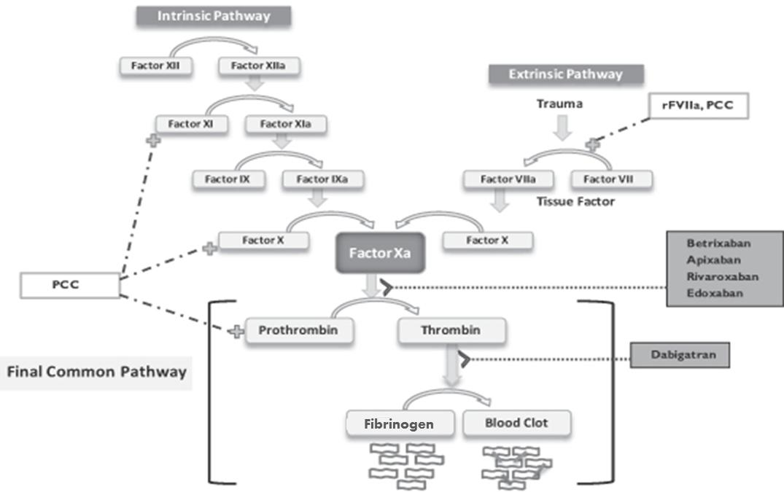
Clotting cascade
Notes:
<number>

Slide 5
Methods
Retrospective study
Previous Cycle onMay 2014 – October 2014
This Cycle on [INSERT DATES HERE]
Review of patient lists
Data collected
EDD
Web V
SCR
Endobase
Study repeated February 2015 - present
Notes:
<number>

Slide 6
Data collected
Length of stay
Hb on admission
Diagnosis
Age
Gender
Medications
Aspirin, Clopidogrel, Warfarin, NOAC
Notes:
<number>

Slide 7
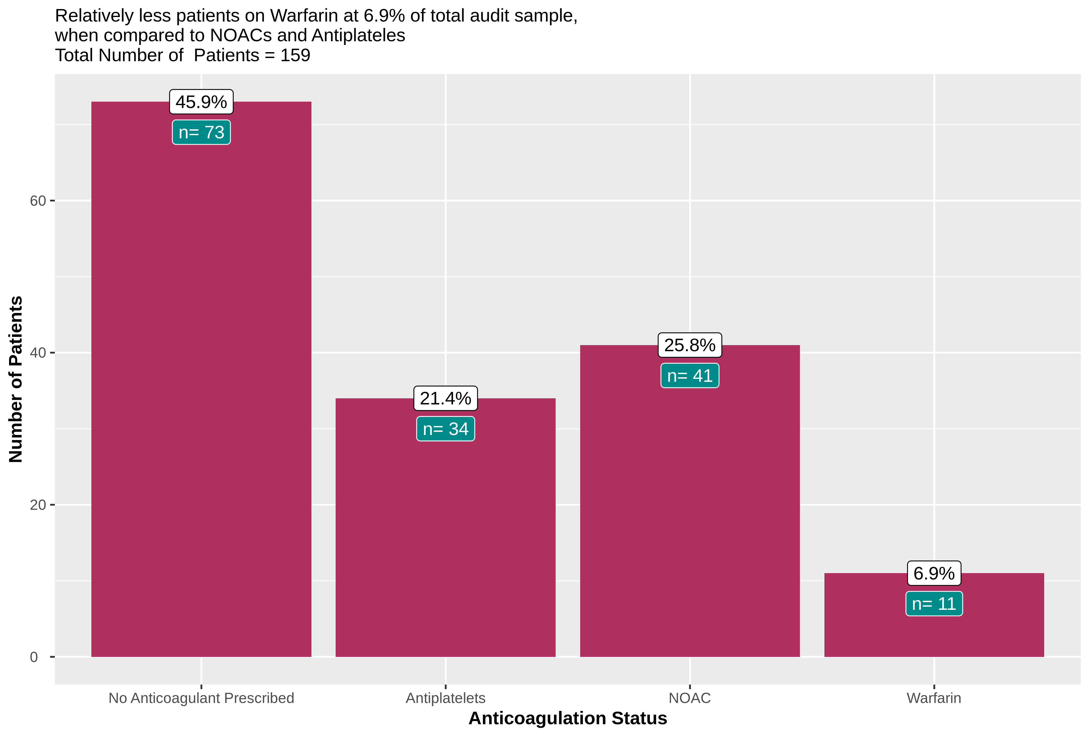
Anti-coagulation Status

Slide 8
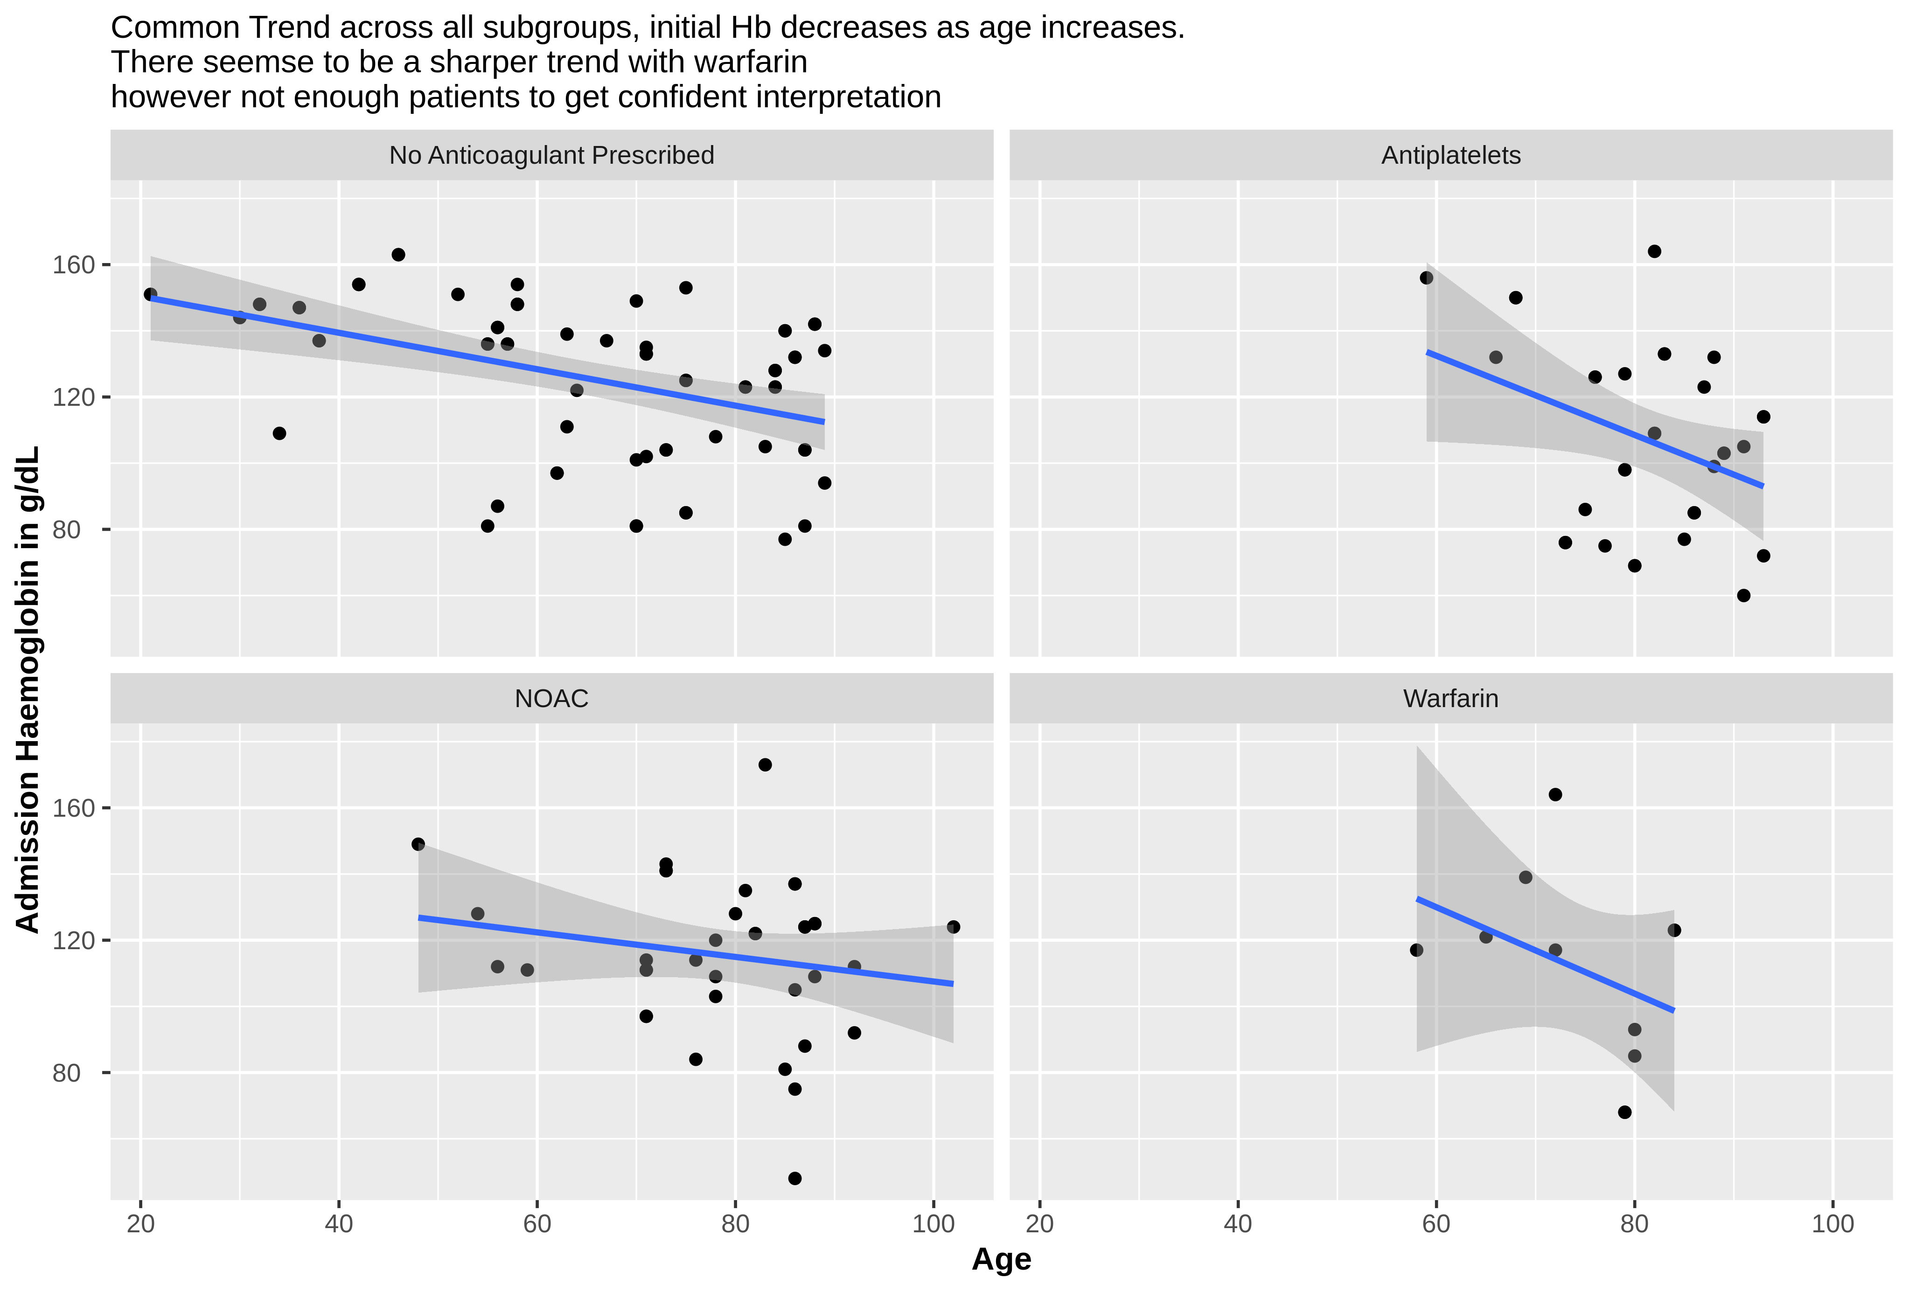
Correlation between Hb on Admission and Age for the 4 groups

Slide 9
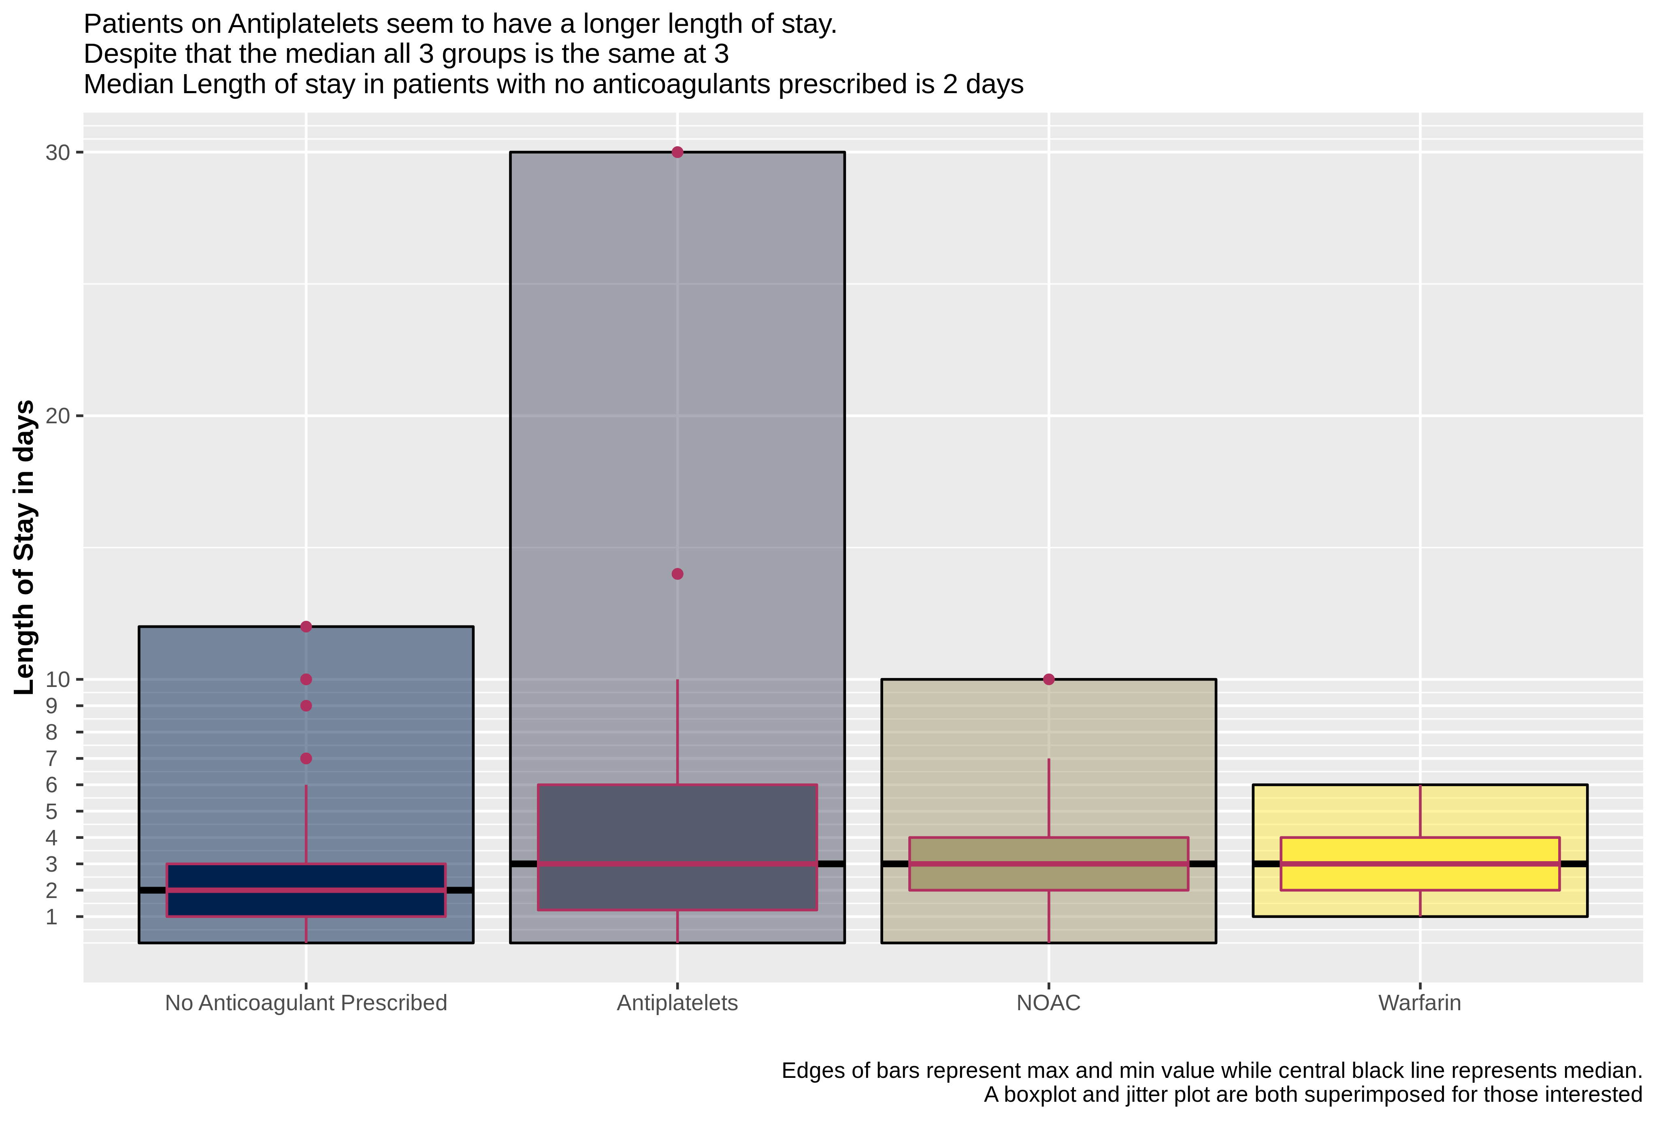
Length of Stay

Slide 10
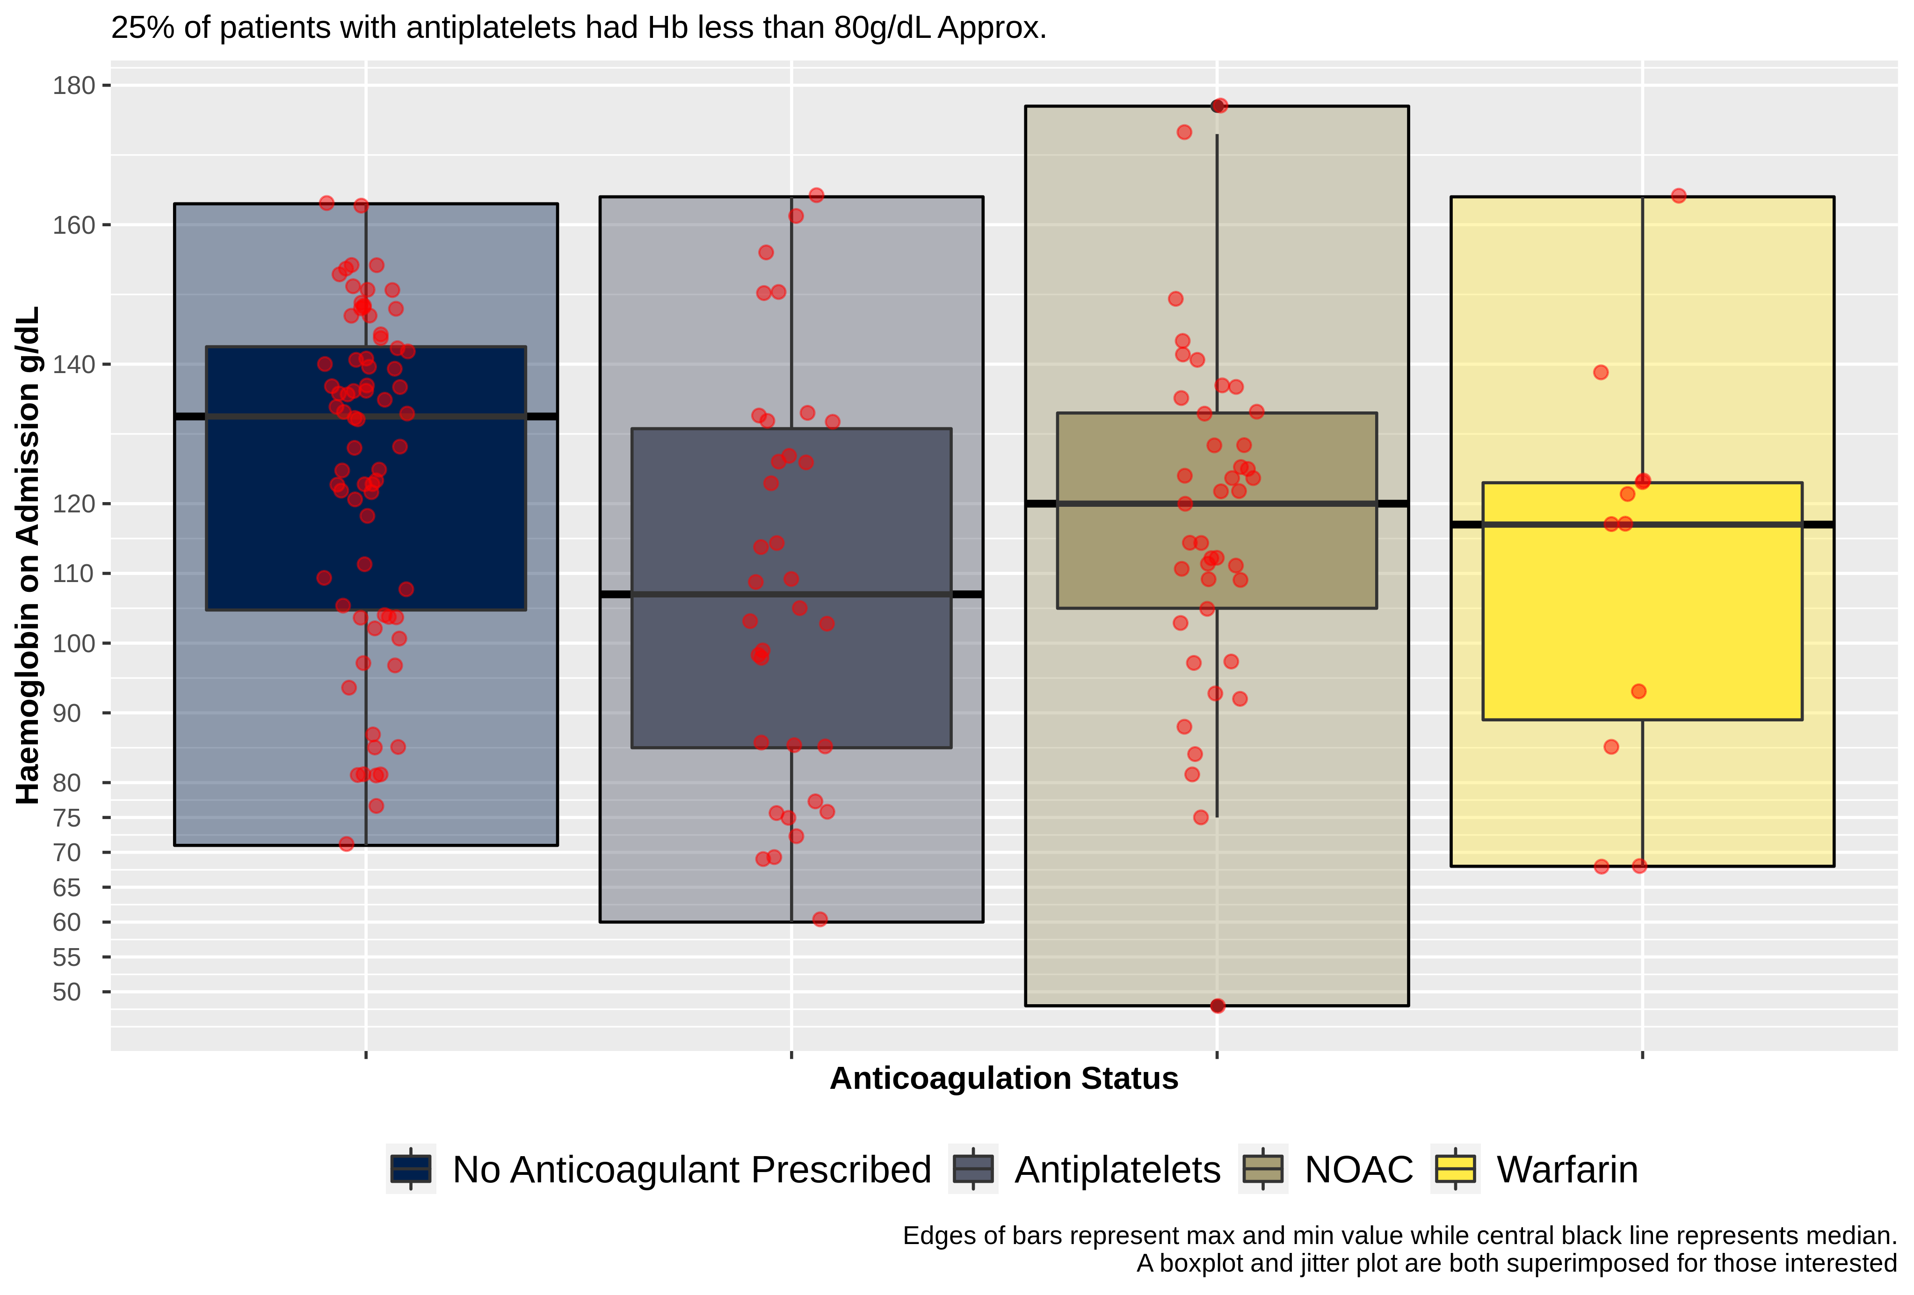
Hb Level on Admission Versus Anti-coagulation status

Slide 11
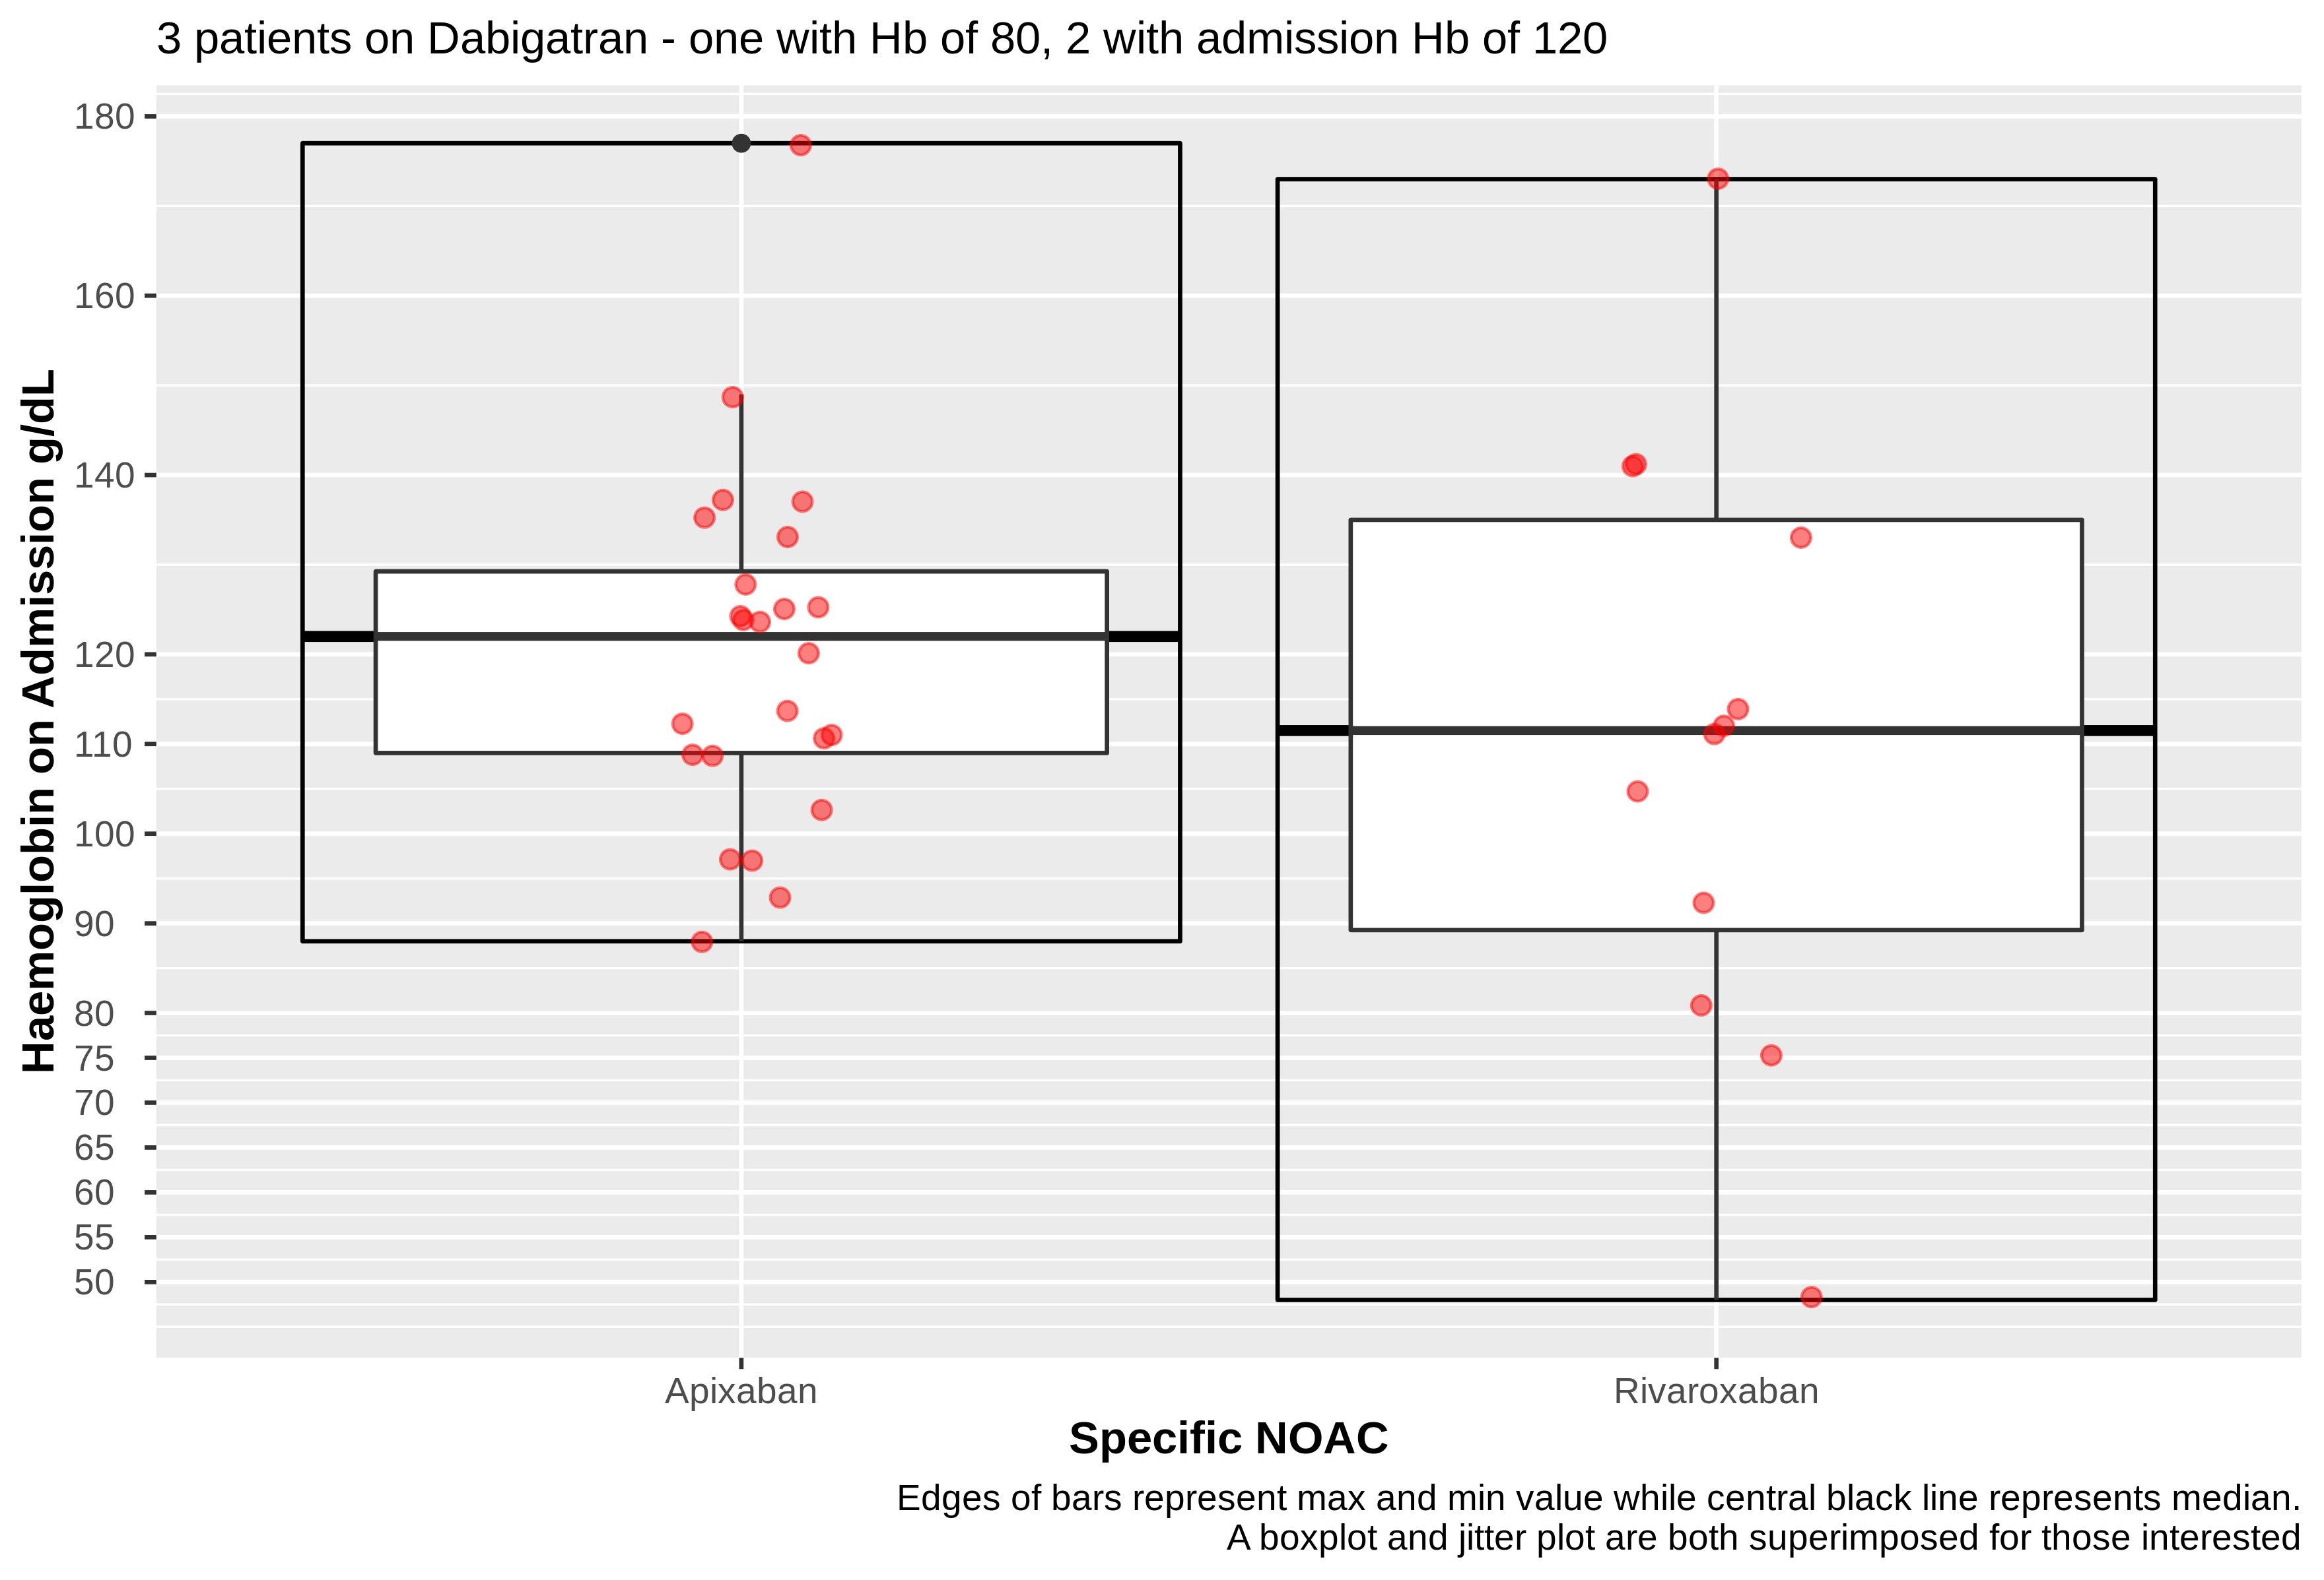
Apixaban and Rivaroxaban were most commonly used NOACs

Slide 12
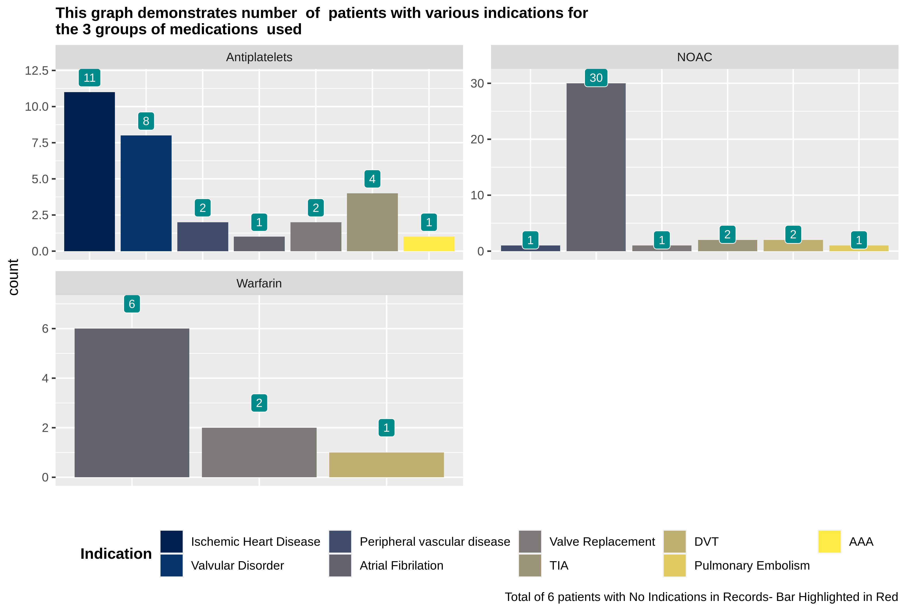

Slide 13
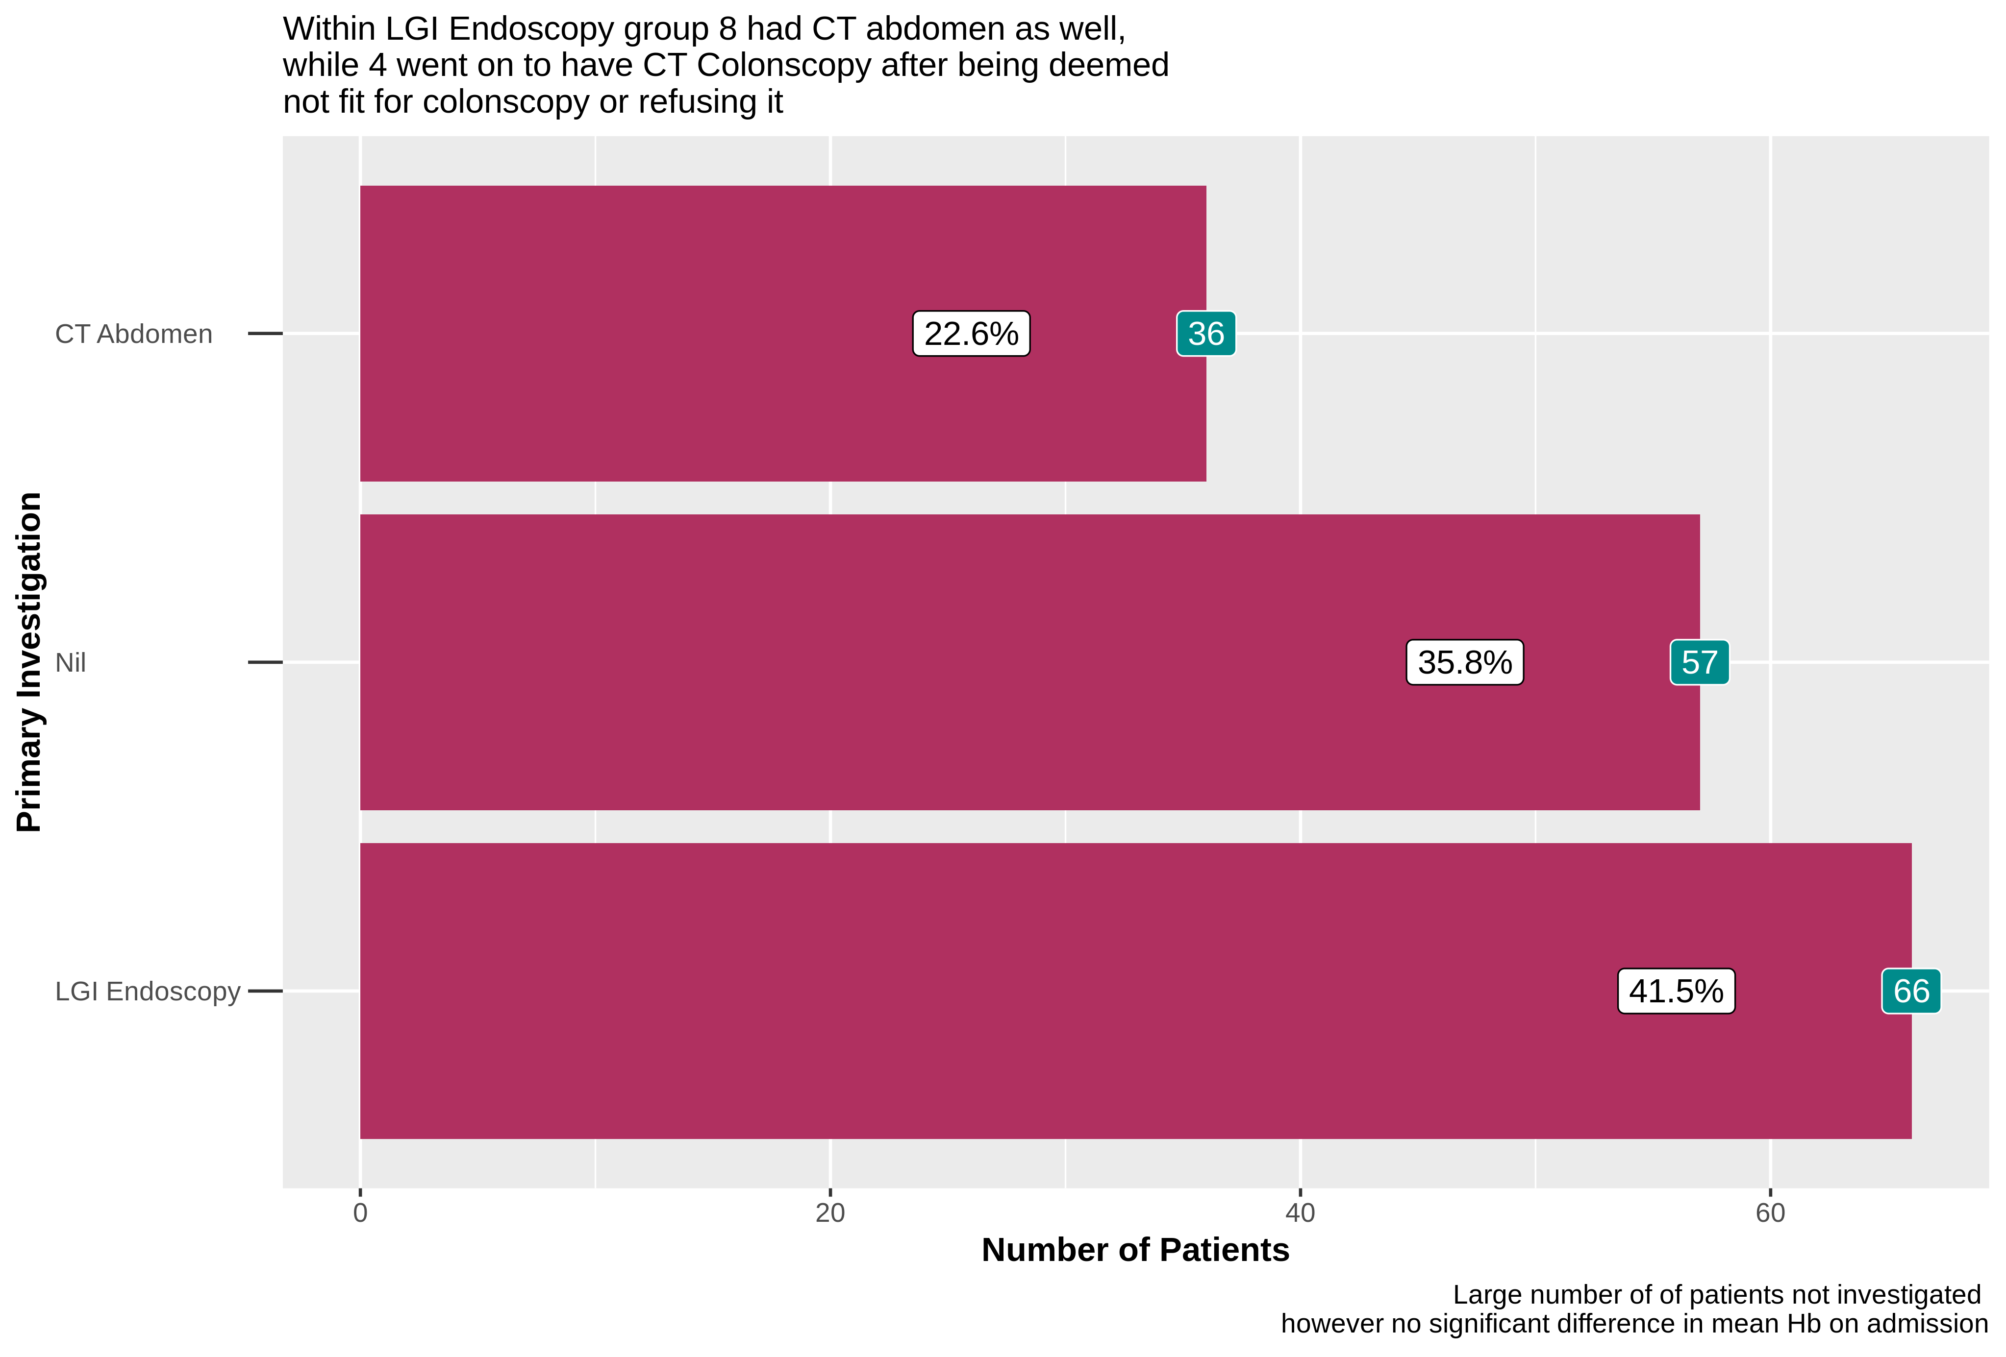

Slide 14
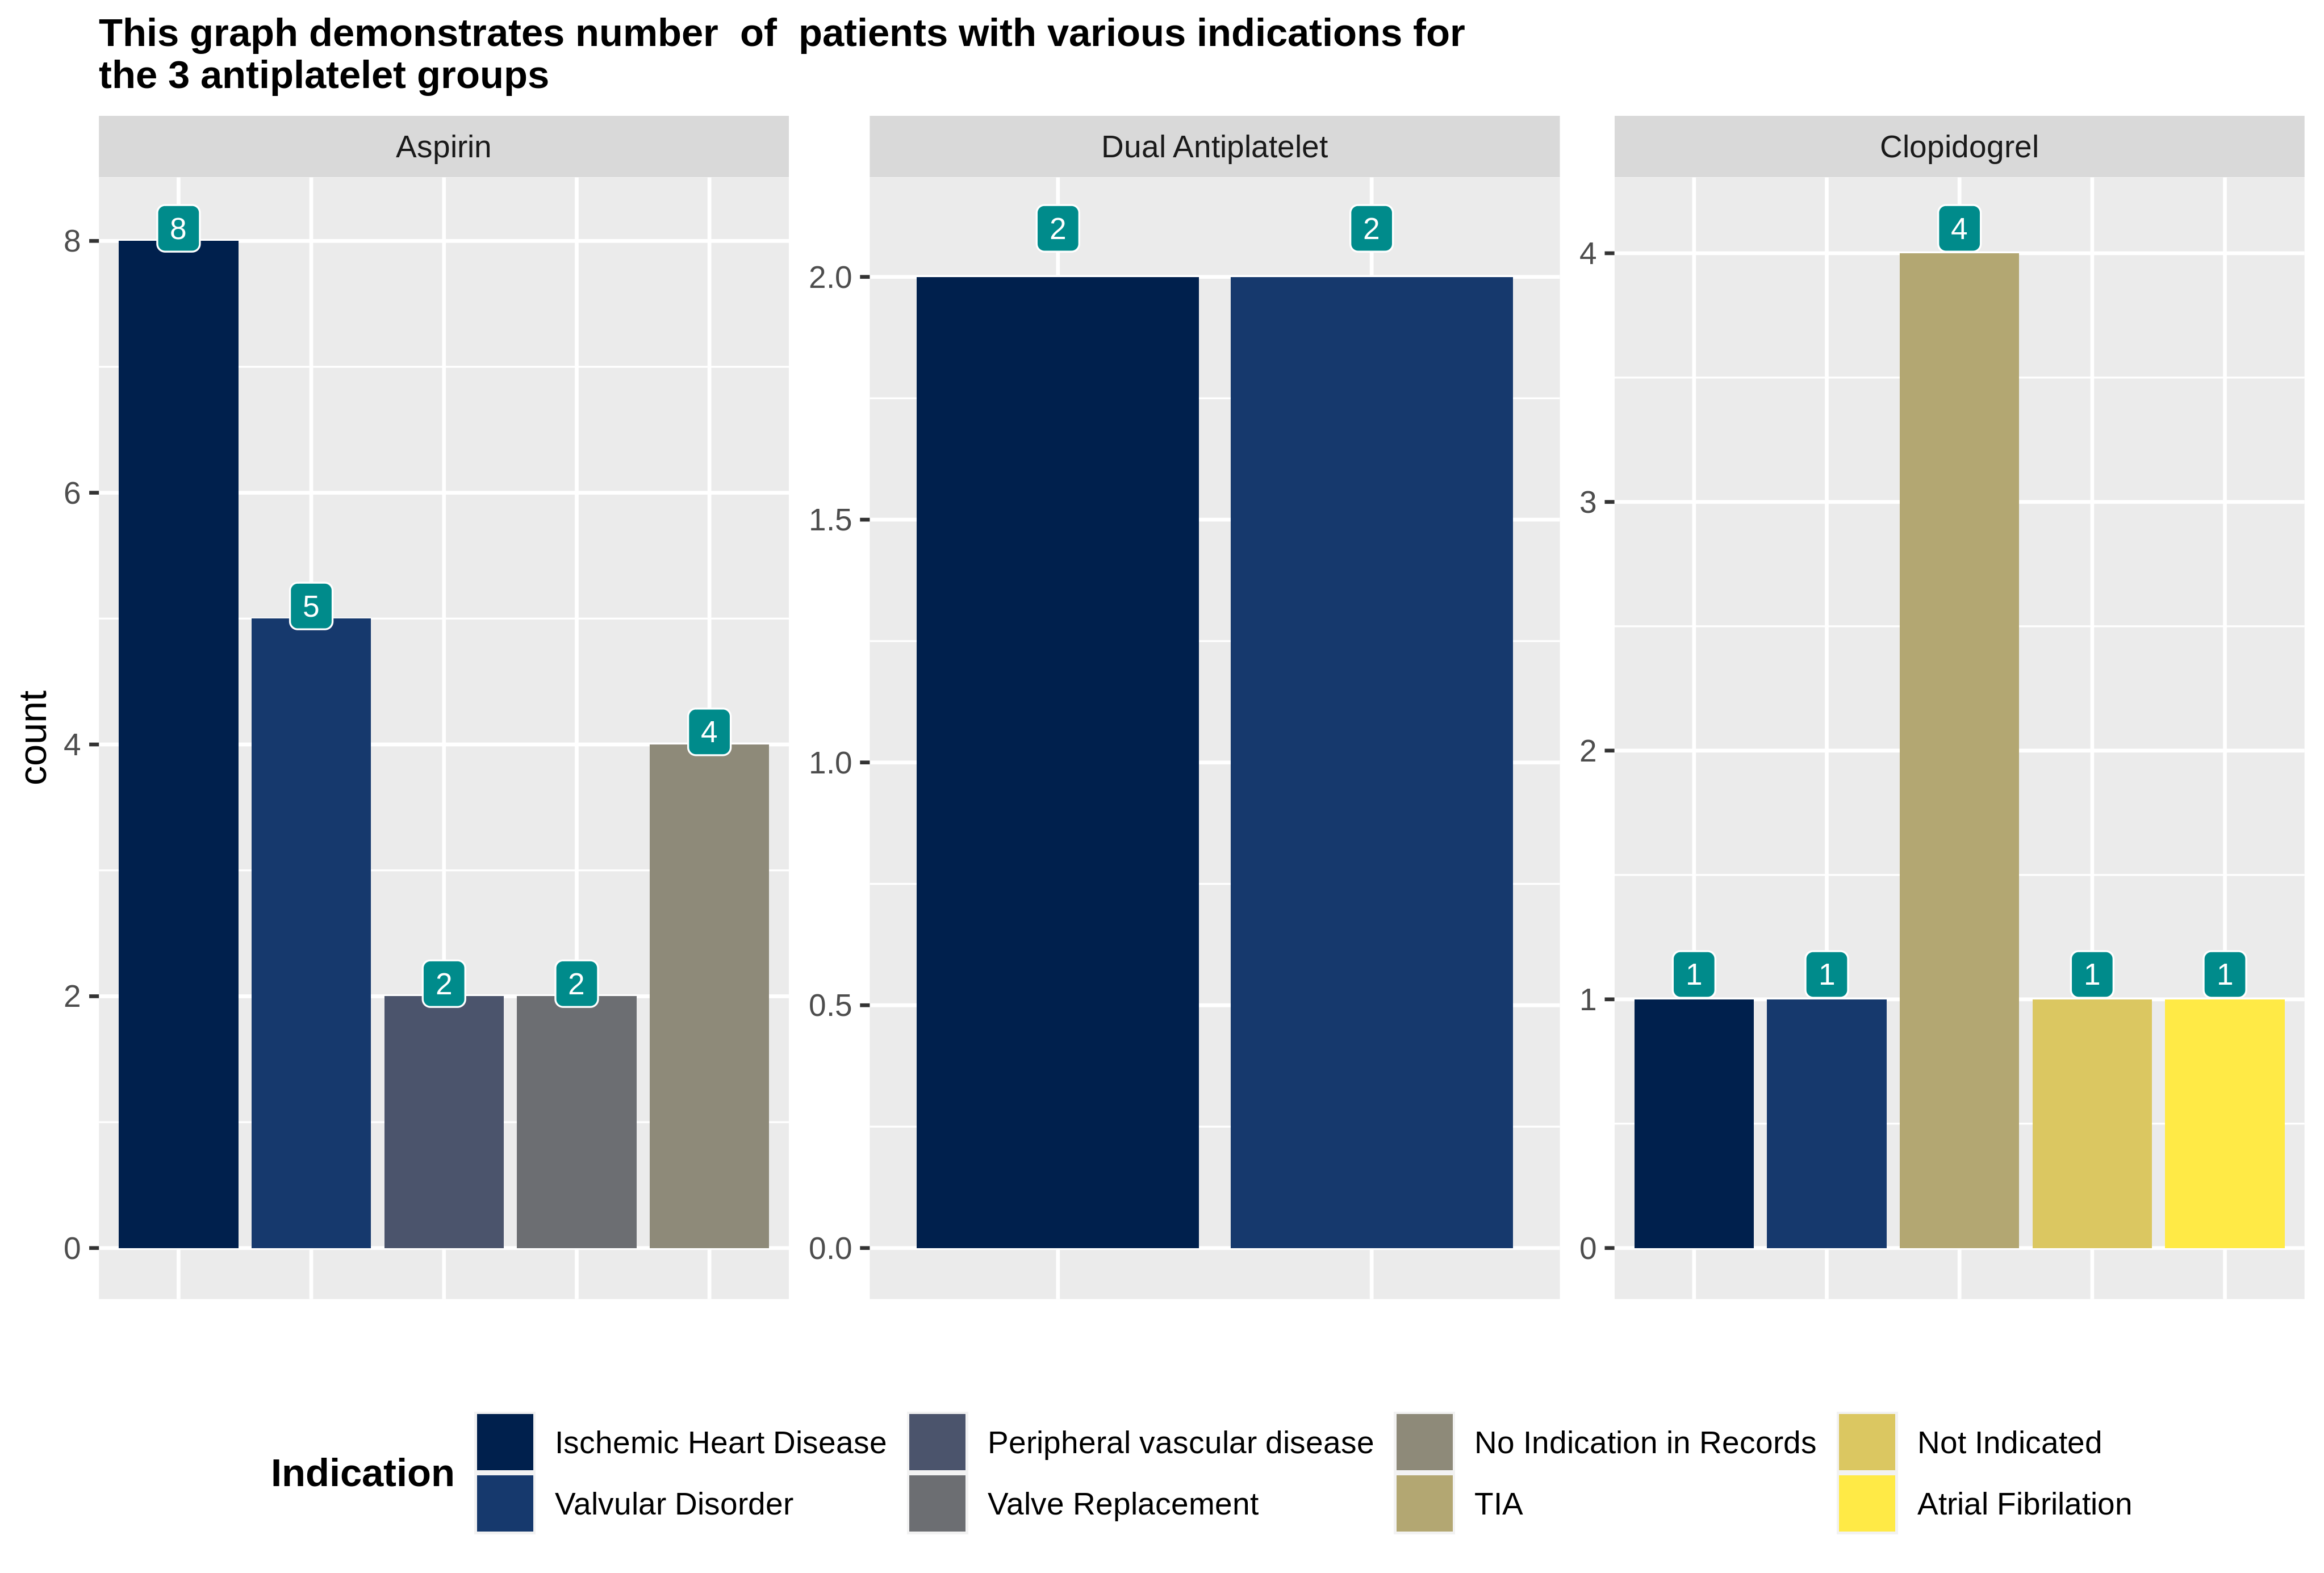

Slide 15
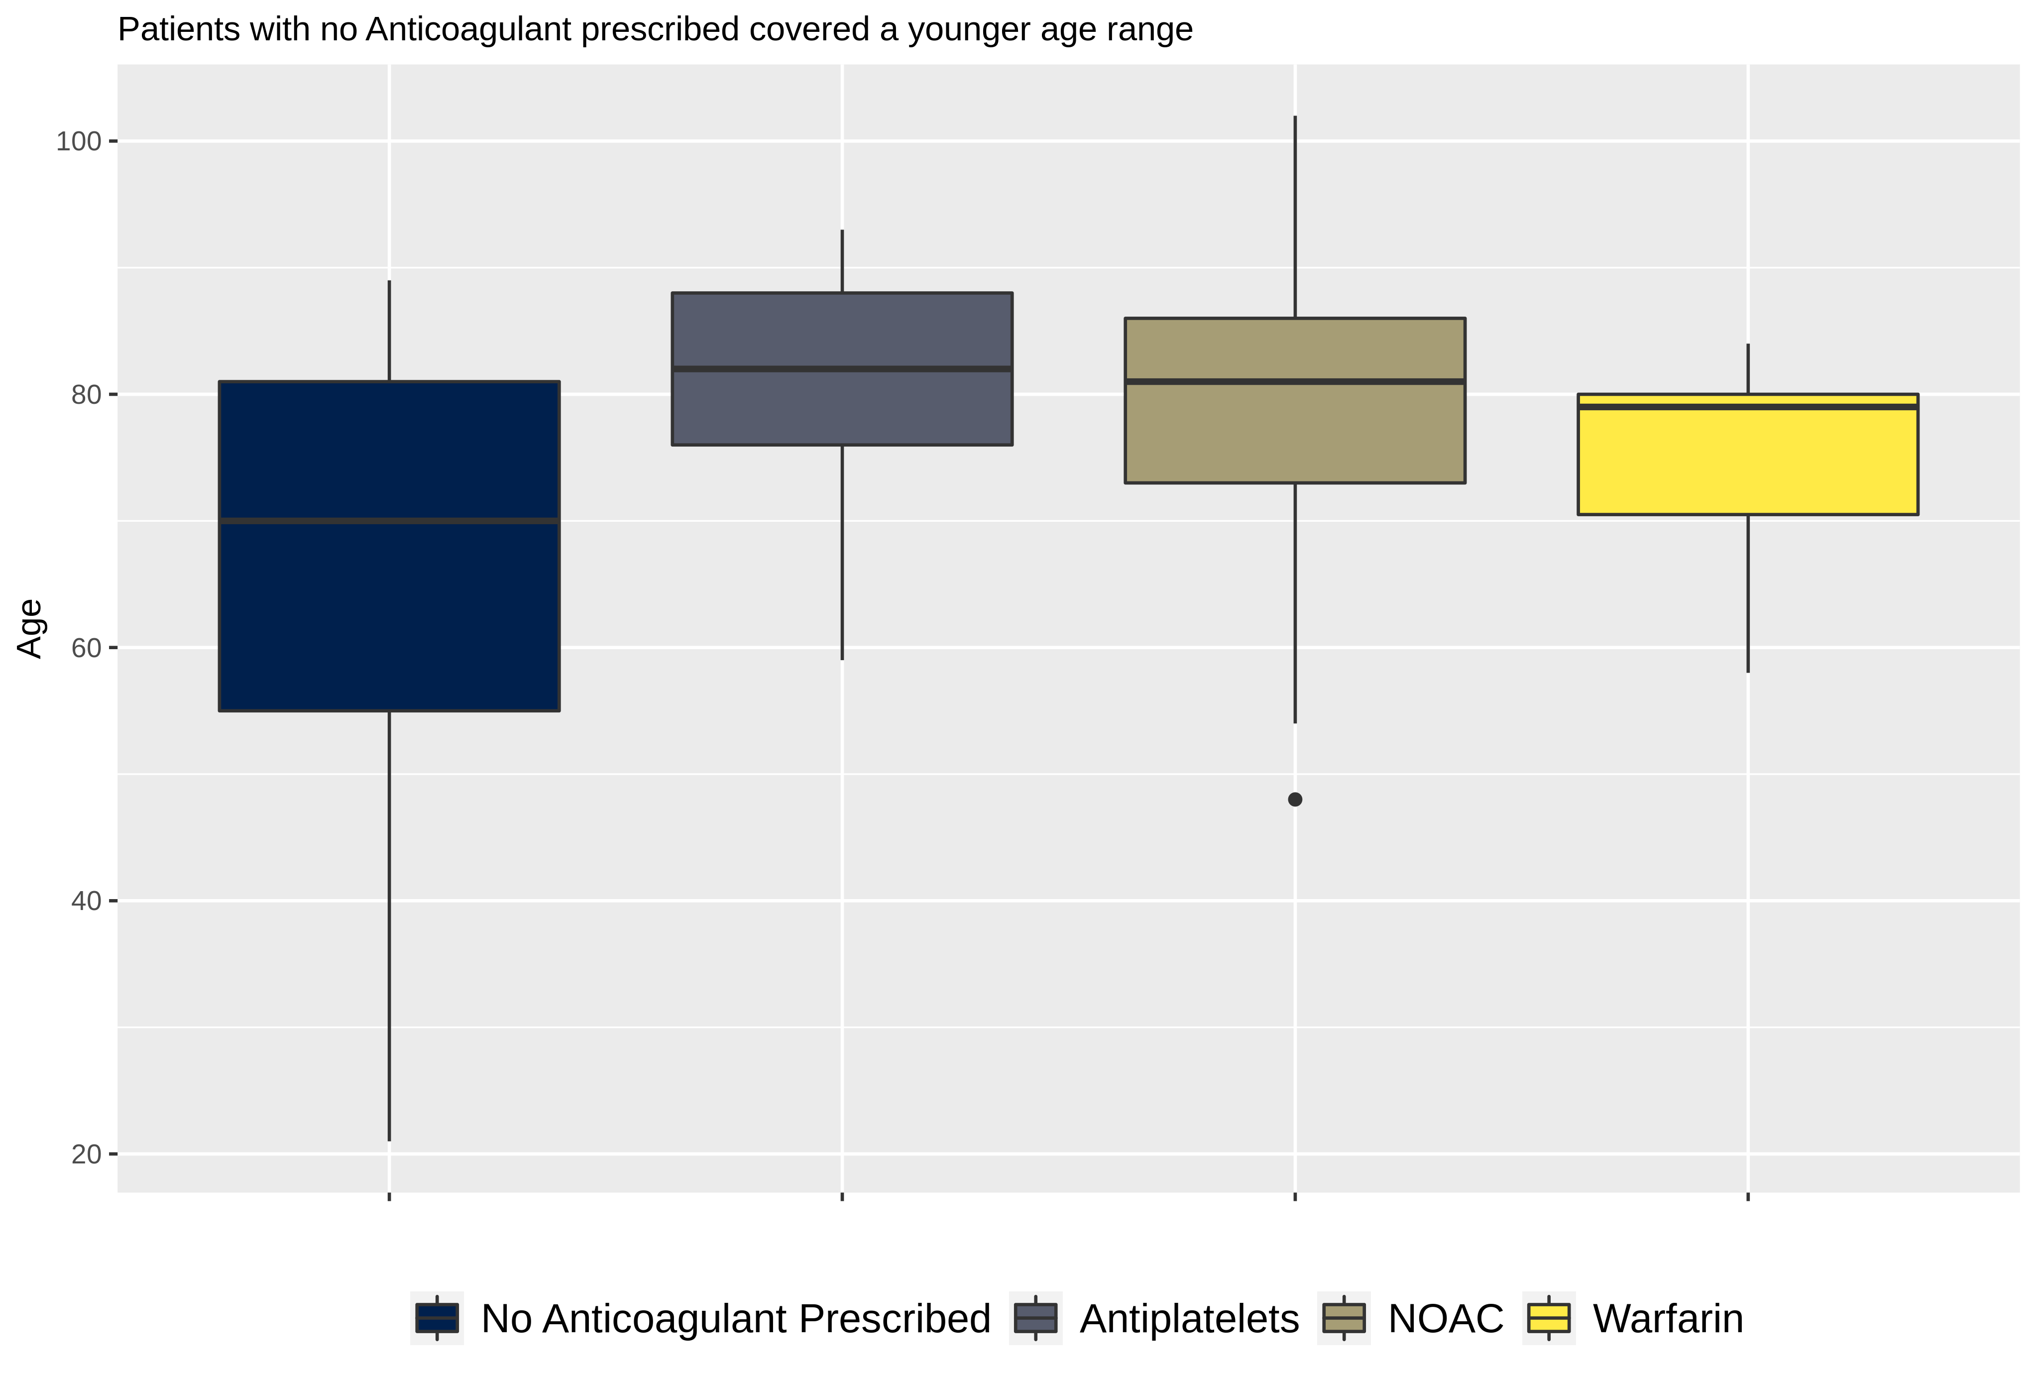
Age disribution for different anti coagulant groups.

Slide 16
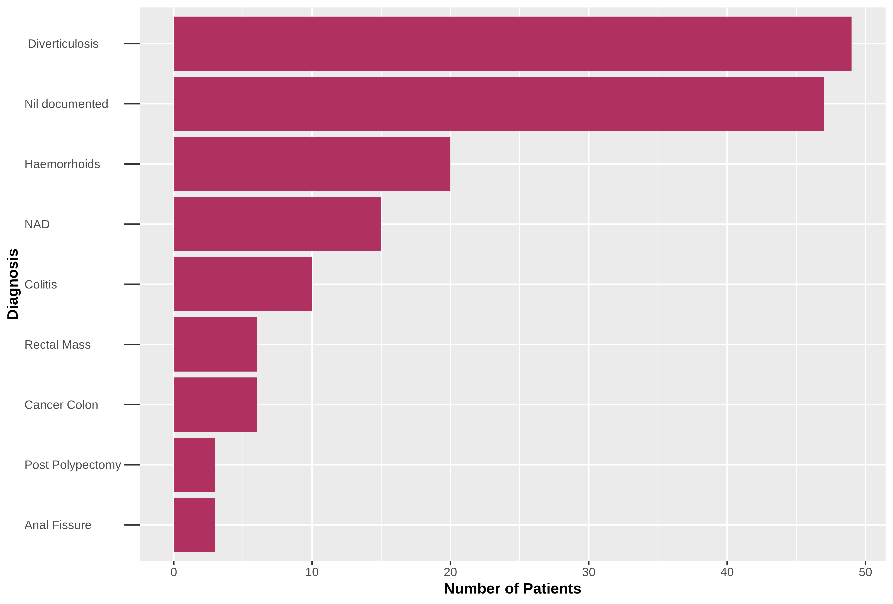

Slide 17
Conclusoin
Compared to previous audit cycles we have less overall length of stay.
In this audited group there seems to be a higher chance of having a lower Hb when on platelets
Limitations include the limited number of patients on Warfarin and rivaroxaban. Unable to examine true effect.

